Slide 1
Celestial-Inertial UAS Navigation in a GPS-negative Environment
Austin Kreulach
University of Arkansas
Department of Computer Science and
Computer Engineering
Harrison Welch
Austin Peay State University
Department of Computer Science and
Information Technology

Slide 2
Presentation Structure
Overview of Celestial Navigation
Our Tools
The Proposed Method
Work to be Completed
Potential for Future Researchers
Notes:
Contains: What exactly we plan to speak about

Slide 3
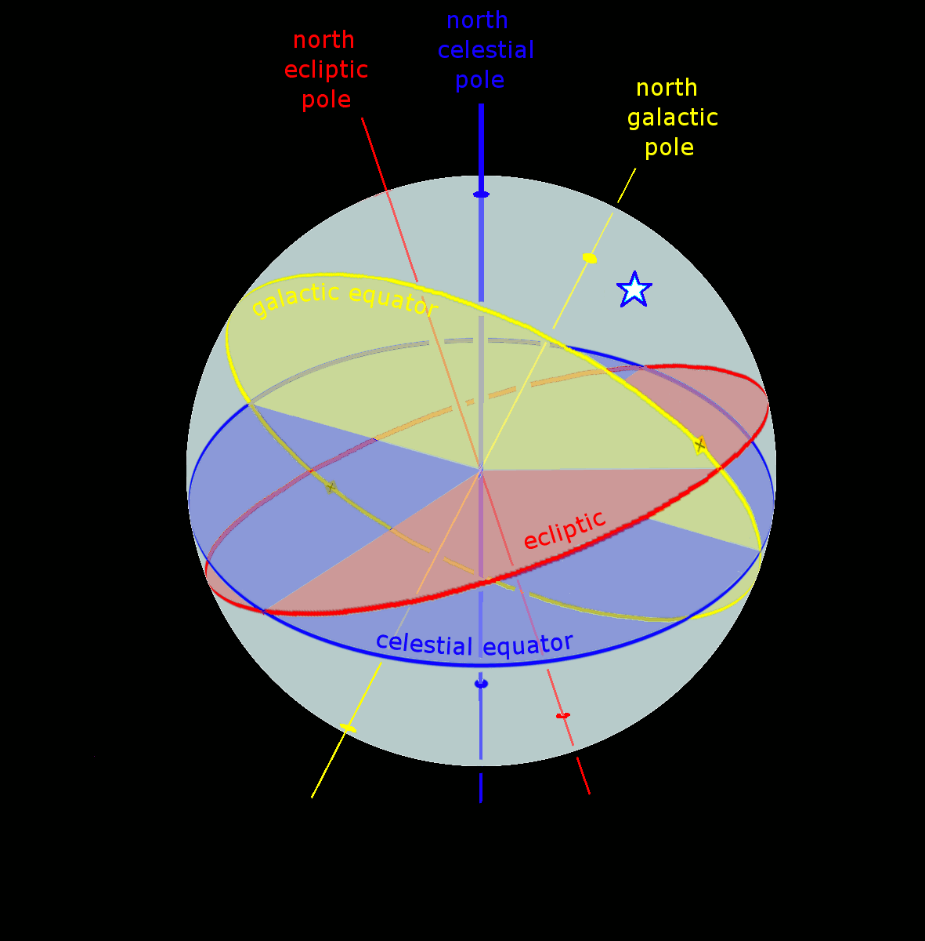
Overview of Celestial Navigation
https://en.wikipedia.org/wiki/Celestial_coordinate_system#/media/File:Ecliptic_equator_galactic_anim.gif
Notes:
Contains: What exactly we plan to speak about

Slide 4
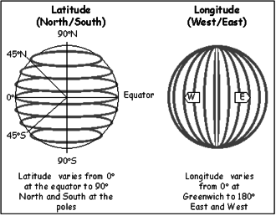
Coordinate System
https://web.archive.org/web/20140813074310/http://www.fedstats.gov/kids/mapstats/concepts_latlg.html

Slide 5
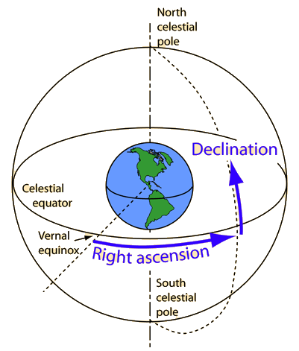
Celestial Coordinate System
http://blog.nameastarlive.com/wp-content/uploads/ra-dec_illustration_wp.jpg

Slide 6
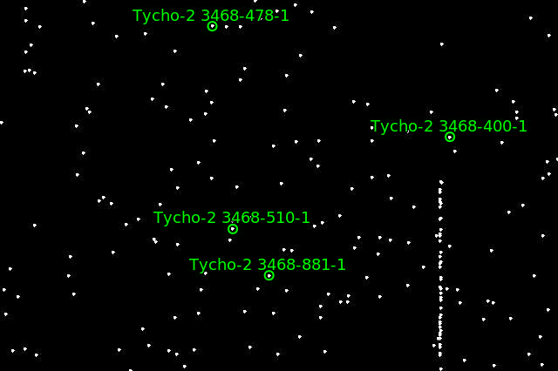
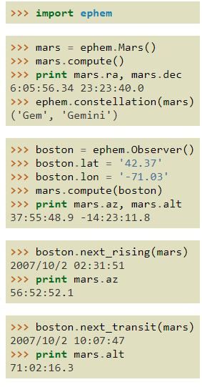
Our Tools
Astrometry.net
ZWO Camera
PyEphem
Credits on following pages
Notes:
Contains: What exactly we plan to speak about

Slide 7
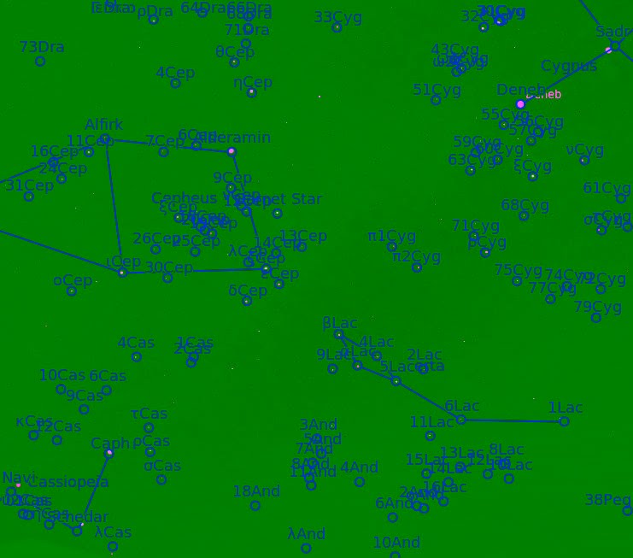
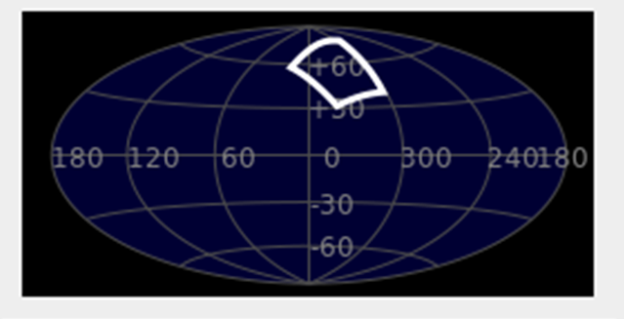
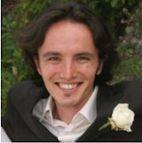
We use Astrometry.net to analyze images of starfields to find named instance stars
The algorithm relies on prior knowledge of where the stars are in the sky
Sloan Digital Sky Survey (yearly release)
Builds “quads” which are groupings of 4 stars
2 most distant points forming an axis
2 remaining star location about that axis are hashed and stored in a database
Bayesian decision of passing the is this a viable “quad”
Expectation of at least 1 million hashes for the entire night sky
Outputs out the RA and DEC of the input image
Capture from Astrometry.net’s Gallery
Dustin Lang, David W. Hogg, Keir Mierle, Michael Blanton, Sam Roweis. “Astrometry.net: Blind astrometric calibration of arbitrary astronomical images.” 2009. Accessed June 14, 2018. https://arxiv.org/pdf/0910.2233.pdf
Screenshot from Sellarium uploaded into nova.astrometry.net

Slide 8
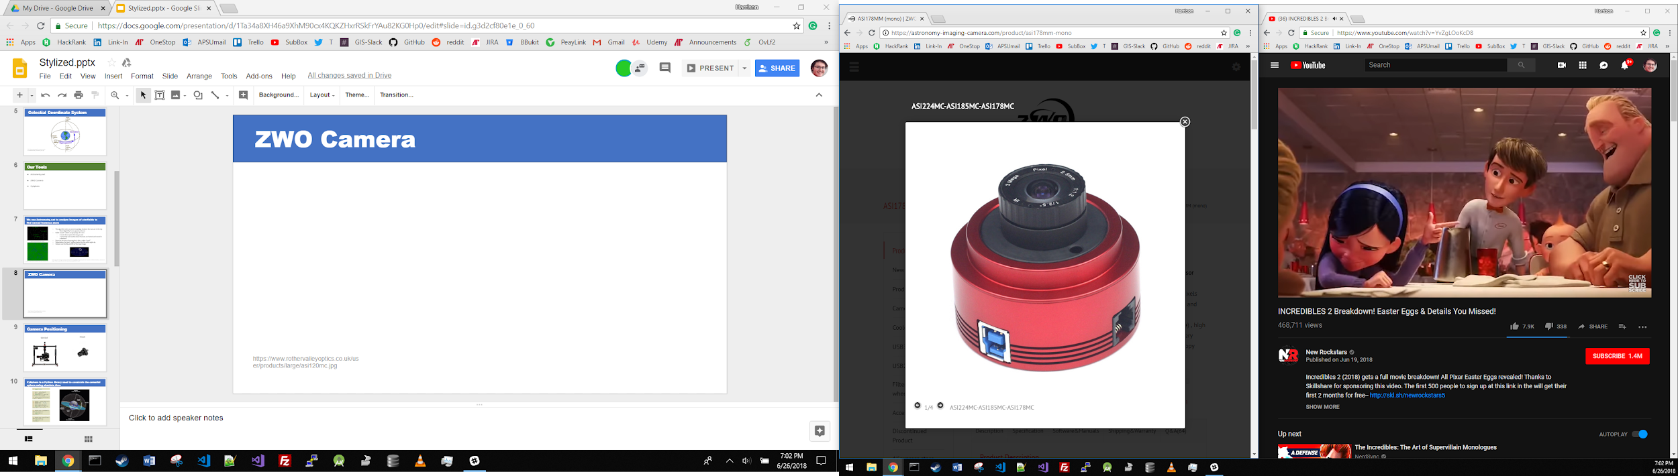
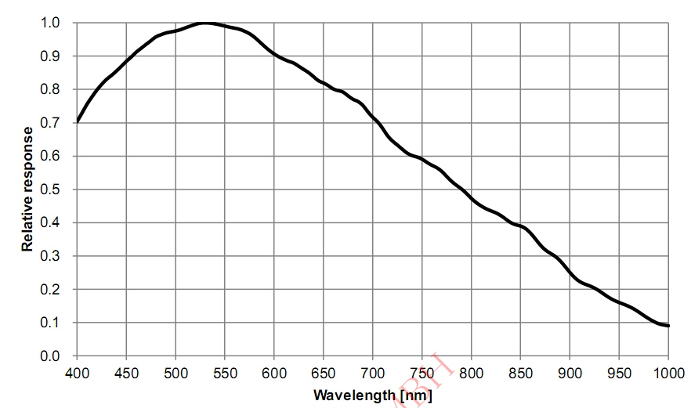
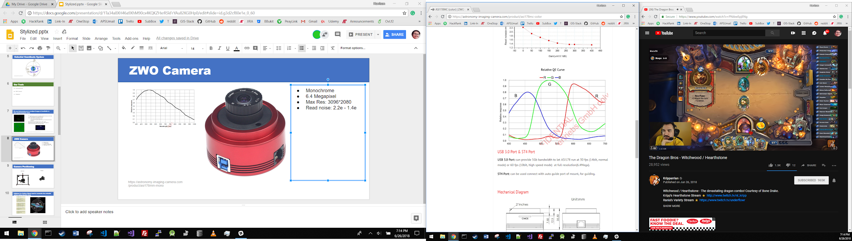
ZWO Camera
Mono
Monochrome
6.4 Megapixel
Max Res: 3096*2080
Read noise: 2.2e - 1.4e
Color
https://astronomy-imaging-camera.com/product/asi178mm-mono

Slide 9
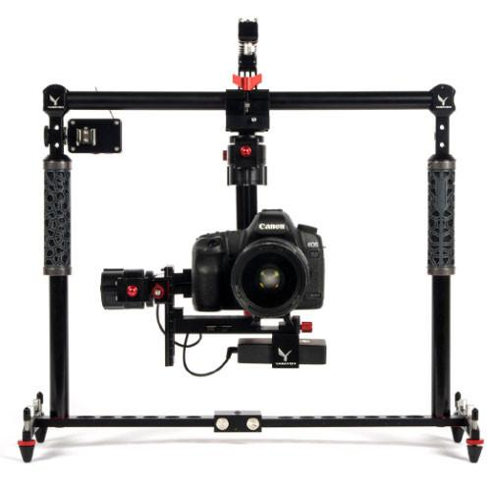
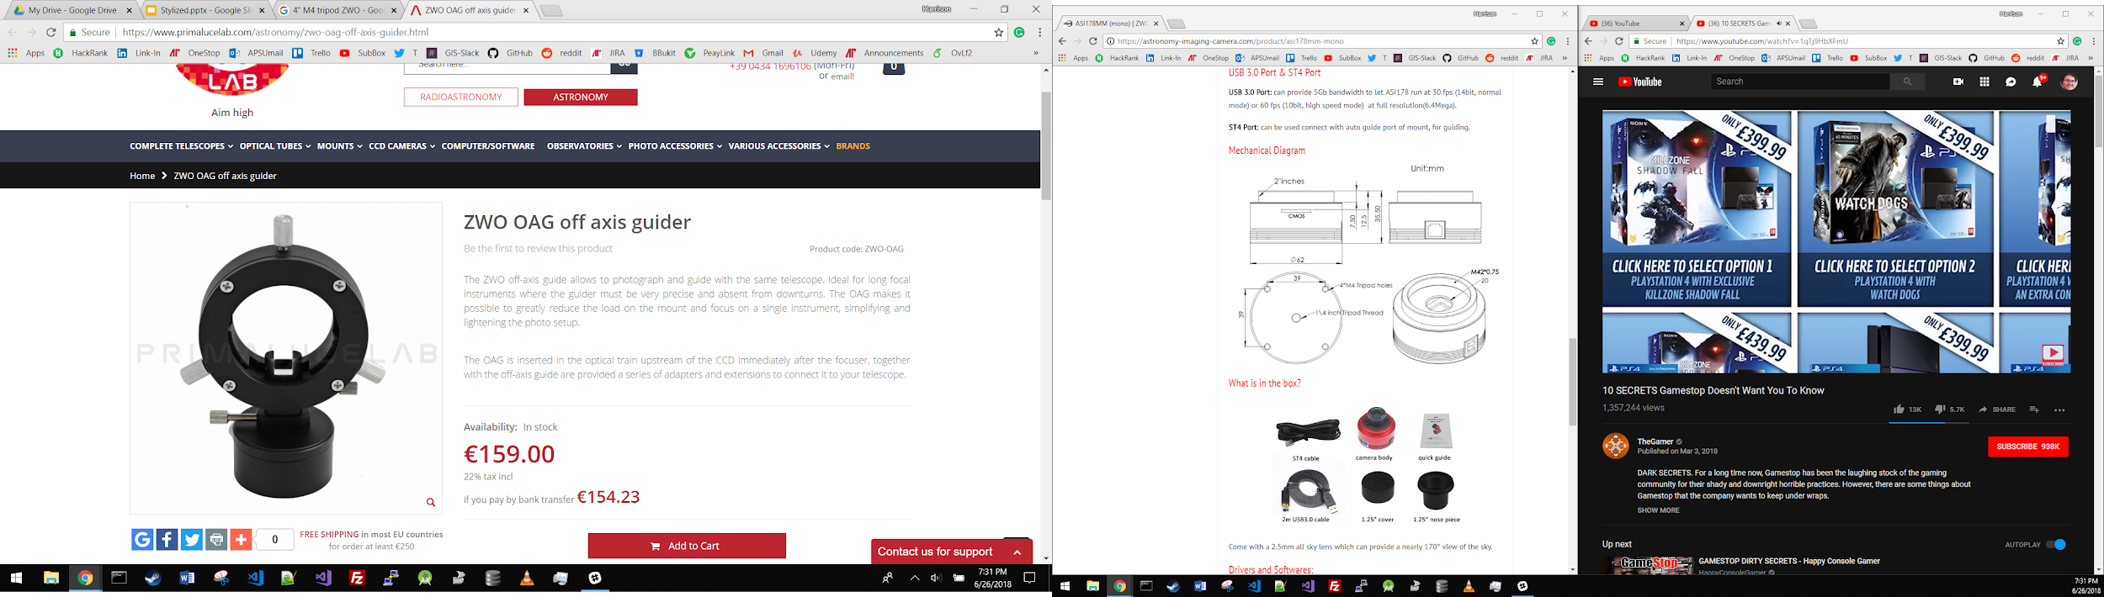
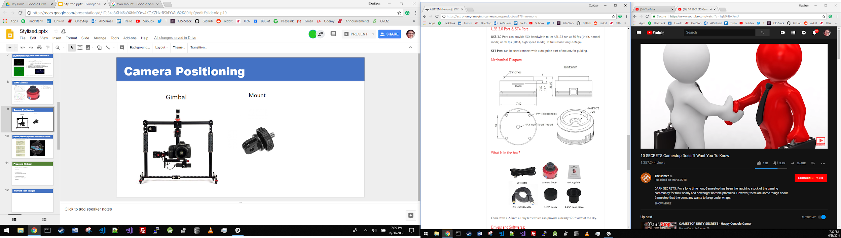
Camera Positioning
Gimbal
Mount

Slide 10
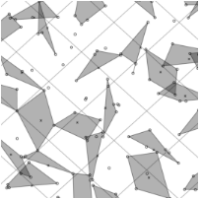
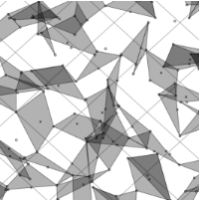
Proposed Method
Gather images with ZWO camera
Analyze with Astrometry.net offline
Use RA and Dec to determine Lat/Long of viewer
Notes:
Contains: What exactly we plan to speak about

Slide 11
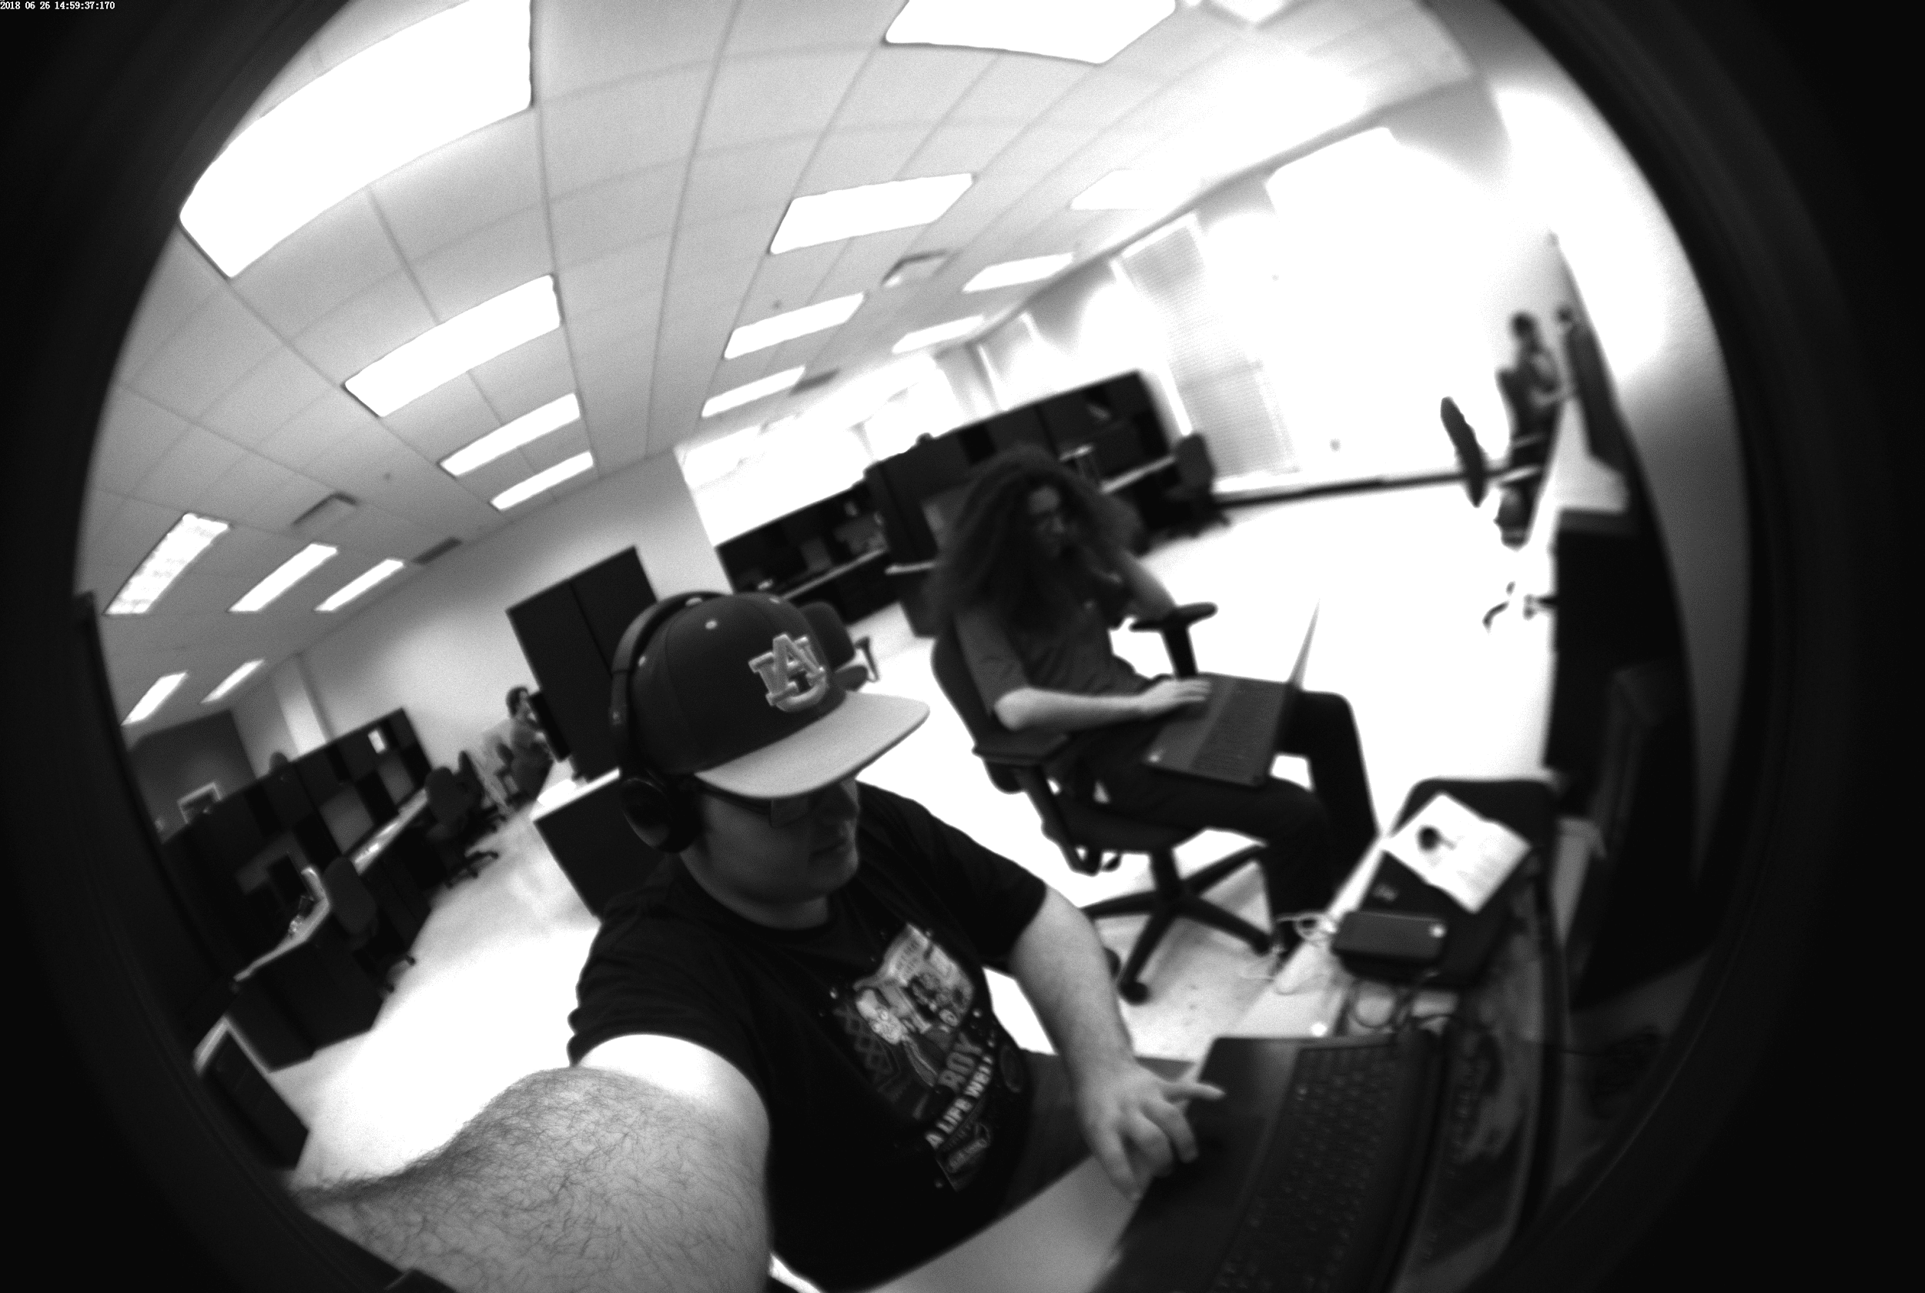
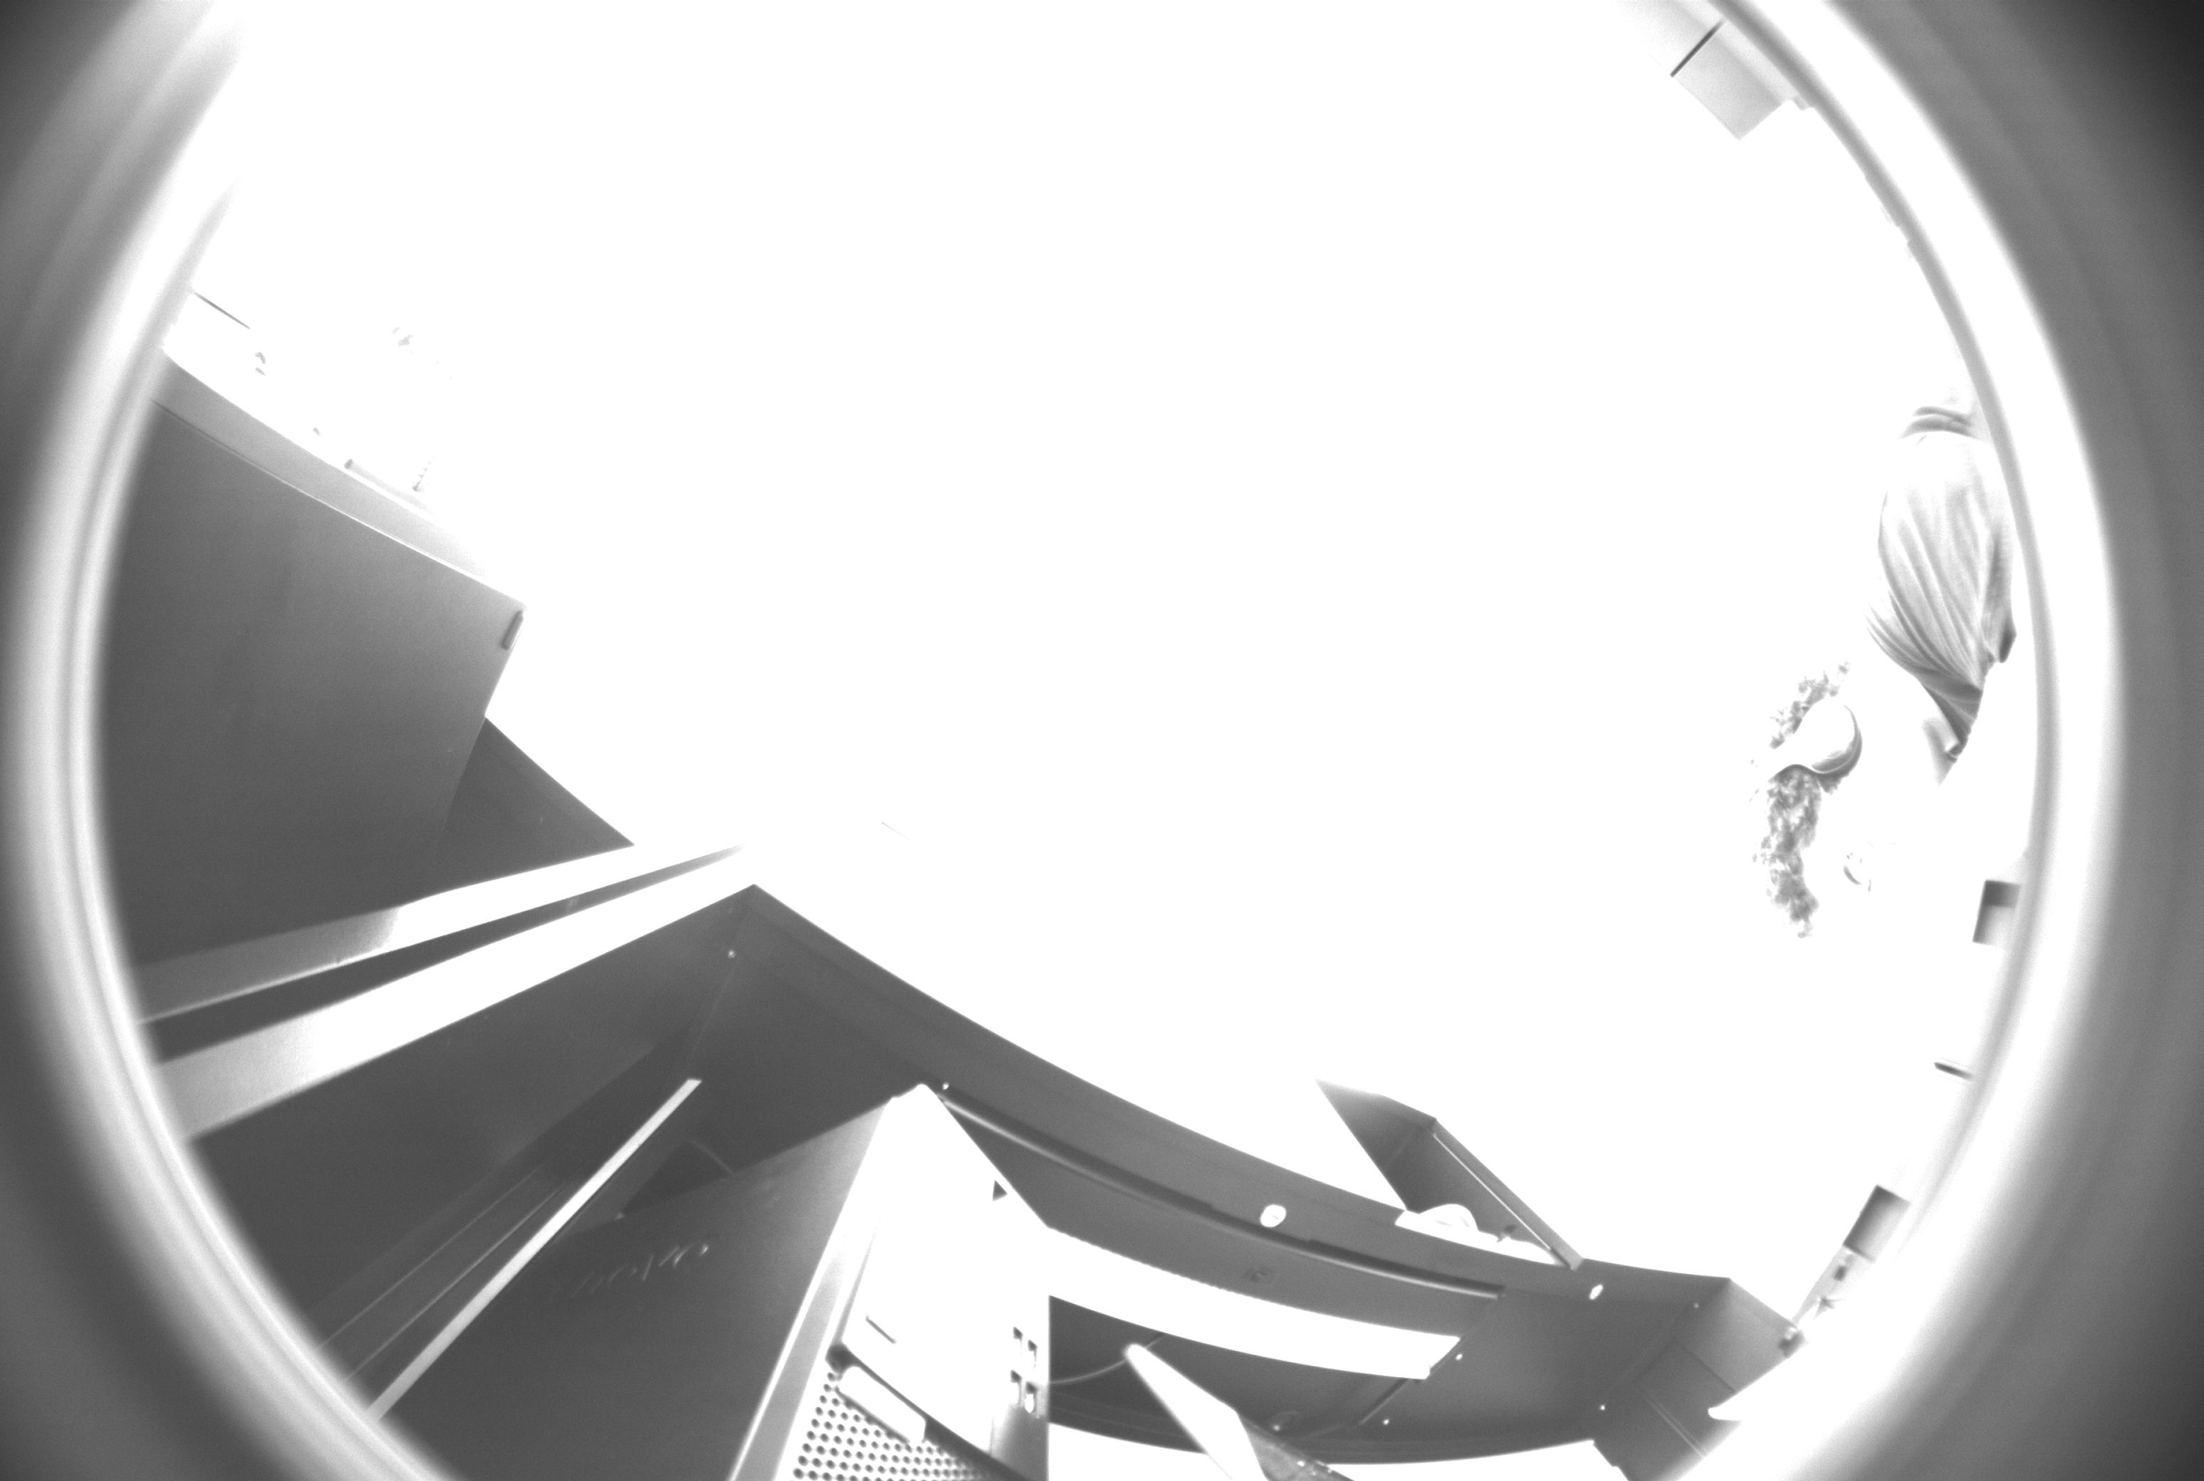
ZWO camera test Images
Monochrome, 6.4 Megapixel, Max Res: 3096*2080, 170 degree full sky “fish eye” lens

Slide 12
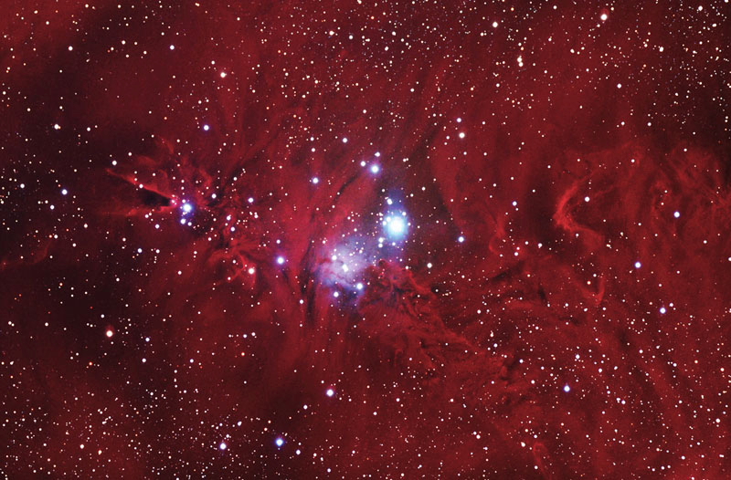
Astrometry.net Outputs
...
weak2: final WCS:
TAN-SIP Structure:
crval=(100.144, 9.79094)
crpix=(379.637, 301.273)
CD = ( -3.7196e-05 -0.0018825 )
( 0.0018824 -3.6006e-05 )
image size = (800 x 526)
SIP order: A=2, B=2, AP=2, BP=2
A = 0 0 4.0578e-06
0 1.9057e-06
-3.7378e-07
B = 0 0 7.9697e-07
0 2.9062e-06
-2.2222e-06
AP = -1.2848e-05 -2.1972e-07 -4.0589e-06
1.7232e-07 -1.9083e-06
3.741e-07
BP = 2.3931e-05 2.4909e-07 -7.9858e-07
-6.2113e-07 -2.906e-06
2.2221e-06
...
Field center: (RA,Dec) = (100.215593, 9.831571) deg.
Field center: (RA H:M:S, Dec D:M:S) = (06:40:51.742, +09:49:53.655).
Field size: 90.3595 x 59.4209 arcminutes
Field rotation angle: up is -91.1139 degrees E of N
...

Slide 13
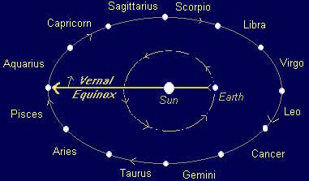
Interpreting RA and Dec
RA - Right Ascension
Dec - Declination
RA corresponds to longitude. The translation from RA to longitude, however, still eludes us at this point in time. To be determined in the following weeks.
Declination corresponds to latitude. If the declination of the center of the image, our zenith, is 48 degrees north, then we are at 48 degrees north latitude.
https://www.satyacenter.com/media/wysiwyg/legacy_article_images/article_904_2.jpg

Slide 14
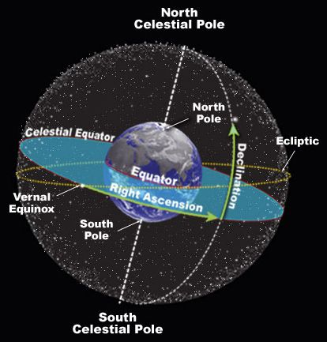
PyEphem is a Python library used to constrain the celestial sphere using absolute time

Slide 15
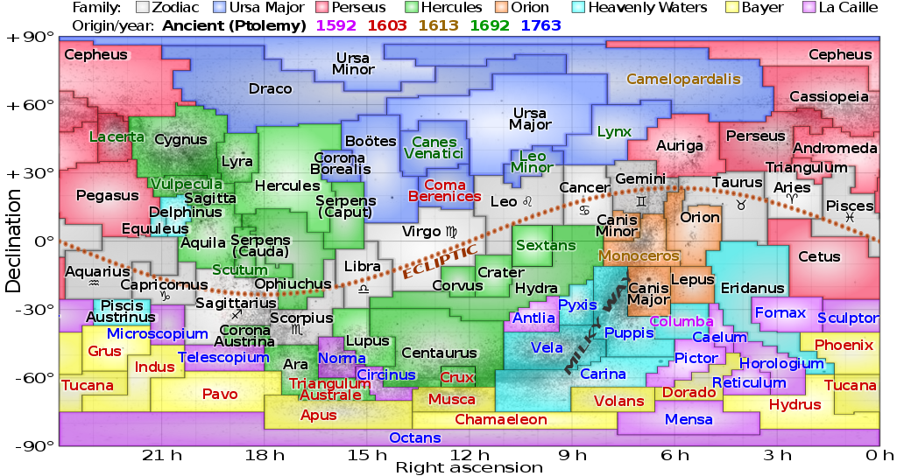
Work to be Completed
Decreasing statistical noise in Astrometry.net
Image Stacking
Filtering
Creating a system for determining longitude from Greenwich time and RA
https://upload.wikimedia.org/wikipedia/commons/thumb/d/d4/Constellations_ecliptic_equirectangular_plot.svg/1024px-Constellations_ecliptic_equirectangular_plot.svg.png
Notes:
Contains: What exactly we plan to speak about

Slide 16
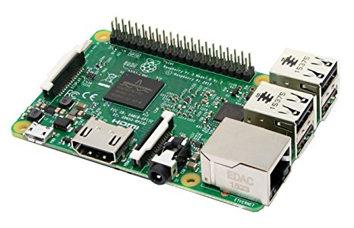
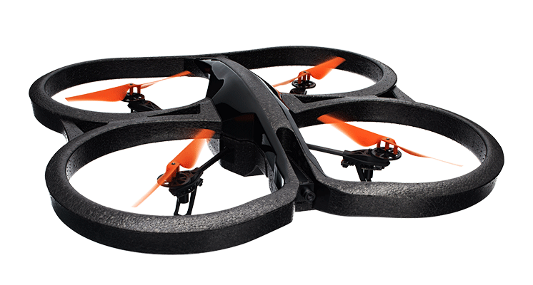
Methods
ZWO ASI 178MM Camera
Image stacking
Raspberry Pi
Python
Steven Marple’s python binding library
Parrot AR drone
lift into the air for a higher altitude shot

Slide 17
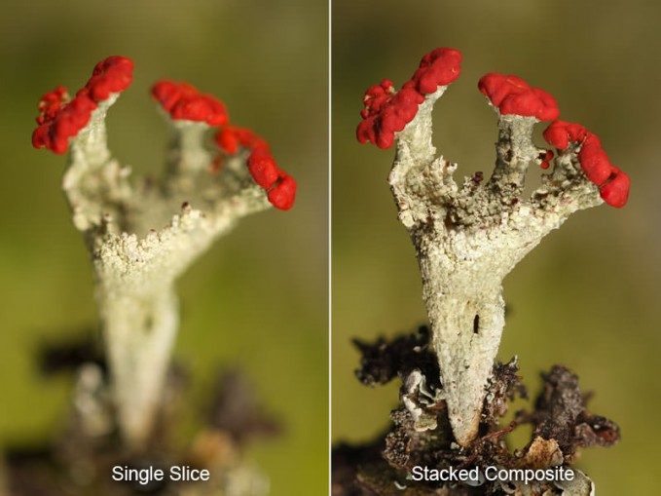
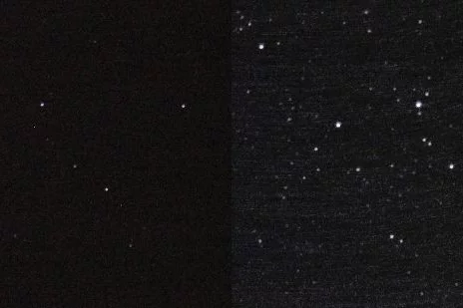
Image Stacking
Photography trick used to sharpen images
Combines images into one with a greater depth of field
https://cdn.instructables.com/FGQ/0TC3/GSUSMKLZ/FGQ0TC3GSUSMKLZ.LARGE.jpg?auto=webp&crop=3:2
https://www.breathingcolor.com/blog/wp-content/uploads/2015/07/BC-FocusStacking-06-679x509.jpg

Slide 18
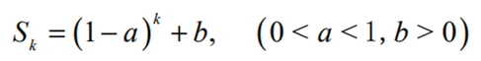
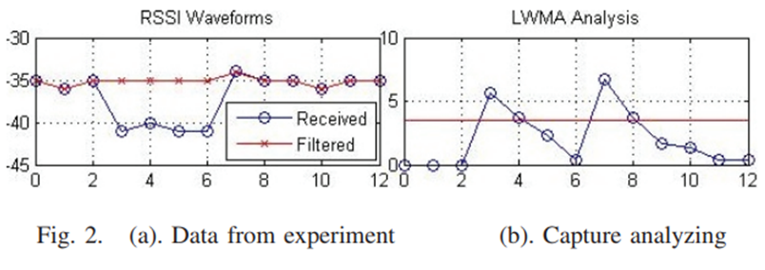
Filtering
Kalman Filtering
Memory fading unscented
Max error reduced by 21.4% and mean error reduced by 7.1%
Matrices to filter sooth position estimations from raw data
Exponential Weighted Moving Average (EWMA)
Linearly Weighted Moving Average (LWMA)
Less computationally complex
Remove noise and human interference
X. Wang, J. Qiu, S. Ye and G. Dai, "An advanced fingerprint-based indoor localization scheme for WSNs," 2014 9th IEEE Conference on Industrial Electronics and Applications, Hangzhou, 2014, pp. 2164-2169.
doi: 10.1109/ICIEA.2014.6931530
F. Si, Y. Zhao and X. Zhang, "Memory fading unscented Kalman filter and its application in navigation by stellar refraction," 2017 IEEE Aerospace Conference, Big Sky, MT, 2017, pp. 1-8. Accessed Jun 15, 2018. http://ieeexplore.ieee.org/stamp/stamp.jsp?tp=&arnumber=7943569&isnumber=7943554

Slide 19
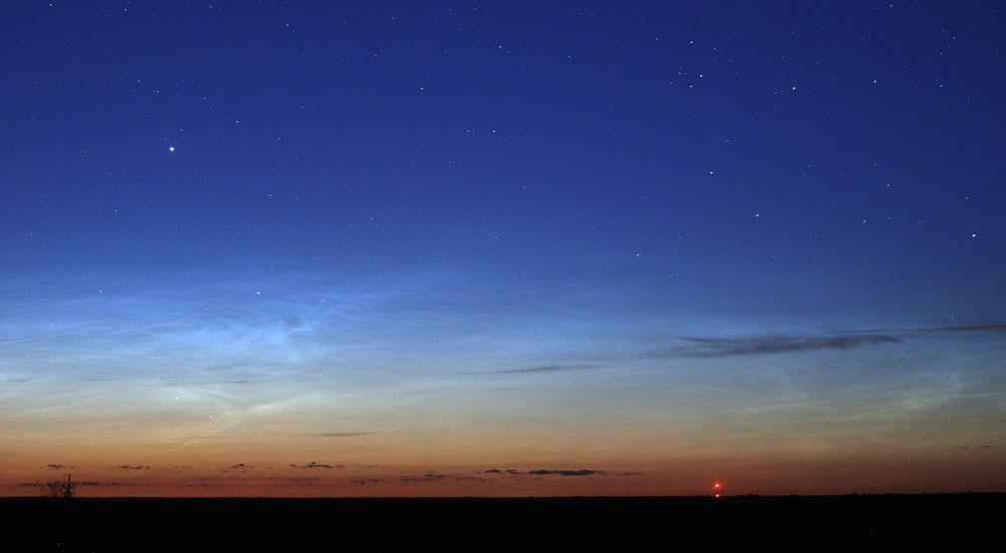
Potential Points of Failure
Magnification of error
Astrometry.net
Runtime speed
Accuracy
Calculations
Day and twilight analysis
Will there be enough stars
Can this work in the daytime?
Photography quality
Capture Speed
ISO number,
Aperture and focal length
Vehicular Attitude vs. Photography
Weather
Moon
https://stgreenie.wordpress.com/2014/10/05/star-stuck/

Slide 20
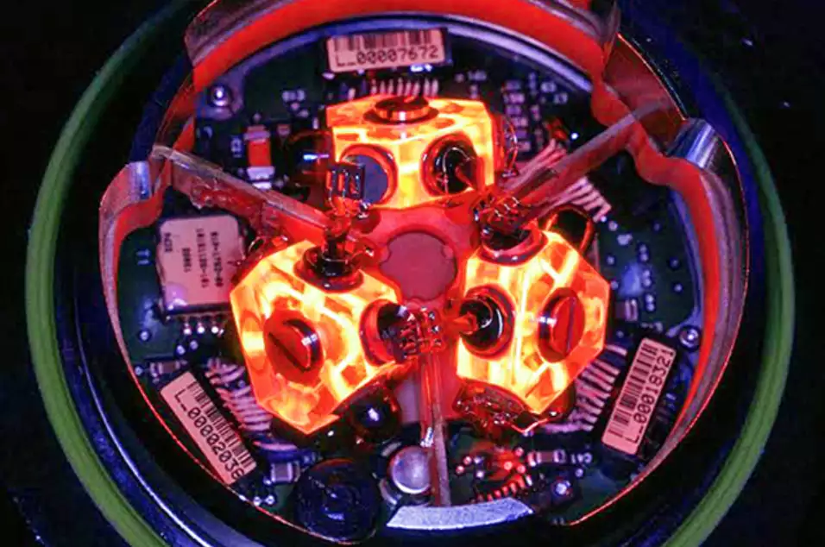
Potential for Future Researchers
Continue statistical refinement
Expand system to work under twilight conditions
Sun tracking
Combine with INS
https://i.kinja-img.com/gawker-media/image/upload/s--qpmp73Ax--/c_fit,f_auto,fl_progressive,q_80,w_636/girka2ijae6givozeqld.jpg
Notes:
Contains: What exactly we plan to speak about

Slide 21
Review
Overview of Celestial Navigation
Our Tools
The Proposed Method
Work to be Completed
Potential for Future Researchers

